Slide 1
HANDOFF IN TELECOMMUNICATIONS
Group-8
Sai Harsha Vardhan Reddy Kolan | qg2321
Sahithi Priya Rathod Kandanelly | it7005
Abhishek Malla | vb7520
Sri Sai Rahul Varma Mudunuri | xi4181
Venkat Ram Reddy Thodeti | yb3152

Slide 2
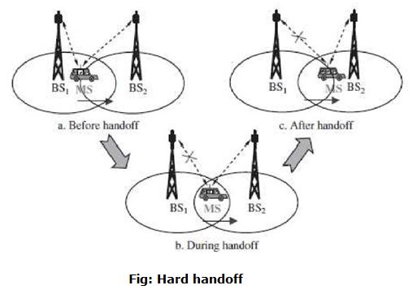
What is a HANDOFF?
Handoff is the process of shifting the mobile connection connected to one core network to another core network.

Slide 3
When does a Handoff takes place
• When the mobile phone moves from one network coverage area to another area.
When the tower reaches its maximum limit of connected devices.
Handoffs may also occur when there is an interference of calls using the same frequency for communication.

Slide 4
How to identify Handoff?
Machine learning algorithms identify the patterns(explained in before slide) and make a handoff decision.
What factors does a ML model use to classify whether a handoff
Should take place or not?

Slide 5
Factors which influence a Handoff decision
There are many factors that influence a handoff process. The most important factors are:
Received signal strength
Bandwidth
Network Coverage area
Power Consumption
Signal to Noise Ratio

Slide 6
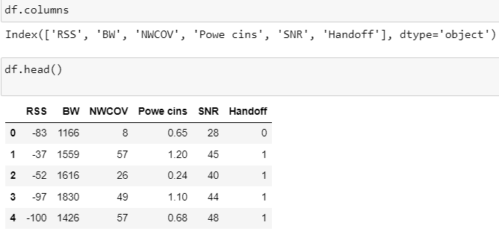
Description of dataset

Slide 7
Explanation of columns:
Received signal strength (RSS): It’s the signal strength received by the mobile phone from the core network (cellular tower). The range of RSS is -100db to -20 db. • Bandwidth (BW): Bandwidth is the range of frequencies which is used in transmitting the signal from cellular tower to mobile phone. The range of bandwidth: 1Kbps to 20MHz. • Network Coverage area (NWCOV): It’s the geographical area within which the tower can send its signals. The range of Network Coverage area is 0-72kms. • Power Consumption (Powe cins): It’s the power consumed by the core network to send the signal to the mobile phone. The range of power consumption is 0-2 Watts.

Slide 8
Explanation of Columns:
• Signal to Noise Ratio (SNR): It’s the ratio between amplitude of received signal and the noise of the signal. The range of SNR is 25db to 50db. • Handoff: It indicates whether the mobile phone should change its connection to the new tower or should remain connected to the same tower. 0 indicates handoff should not take place while 1 indicates handoff should take place.

Slide 9
Methodology
We will see three methods for a handoff decision making:
Logit-model.
Classification Tree
Random-Forests
The dataset has 1000 samples out of which 600 are divided for training and 400 for validation.

Slide 10
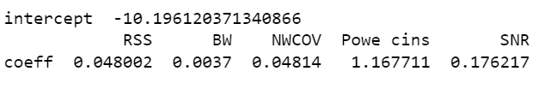
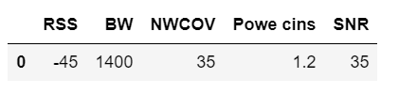
Logit- Model Coefficients
New-Data

Slide 11

Odds Prediction for New-Data

Slide 12
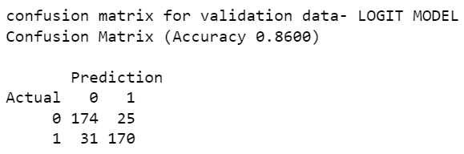
Confusion Matrix-Logit Model

Slide 13
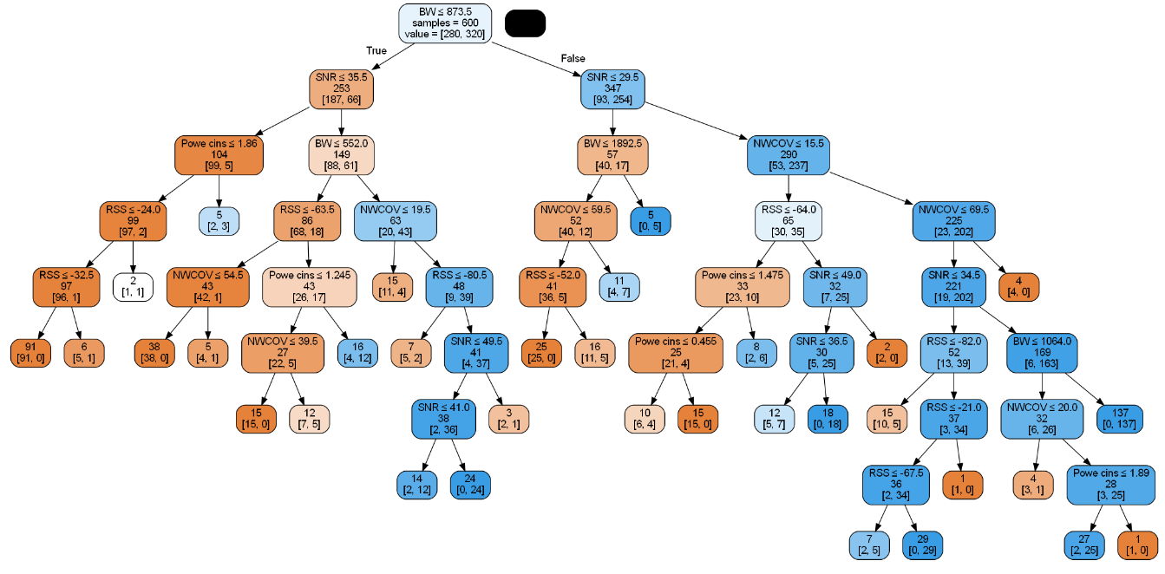
Classification Trees

Slide 14
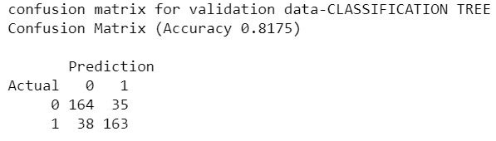
Confusion Matrix-Classification Tree

Slide 15
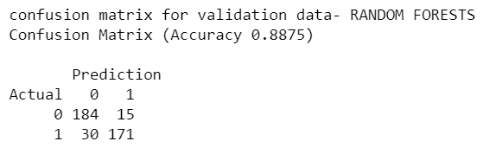
Confusion Matrix-Random Forests

Slide 16
Comparison of the Models
MODEL | ACCURACY | SENSITIVITY | SPECFICITY
Logit | 0.8600 | 0.8462 | 0.8744
Classification-tree | 0.8175 | 0.8105 | 0.824
Random-Forests | 0.8875 | 0.8505 | 0.9247

Slide 17
What after a Handoff Decision
If a device requires a handoff[1] it will choose the network with:
High signal strength
High Bandwidth
High Network coverage area
Low Power-consumption
Low Signal-to-Noise ratio

Slide 18
Conclusions
Random-forests turns out to be the best-model for our dataset.
However, many models as well as many other parameters are considered in making a handoff decision in real world scenario.
The methodology shown in our project is the basic logic behind the complex procedures used by the telecommunication firms in making a handoff decision.

